Slide 1



Data-Driven Storytelling Presentation: Empowering Sales Strategies: Analyzing Account Performance

Slide 2
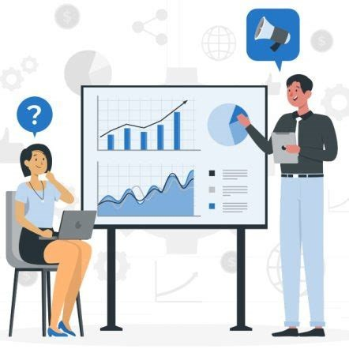
Evaluating Sales Performance: Key Findings
Current Performance:
Overall sales are good but can be improved.
Addressing Underperformance:
Closing poorly performing accounts frees up resources.
Focus on High-Growth Areas:
Strongest growth seen in online retailer accounts.
Strategic Allocation:
Invest resources into high-growth online retailer accounts.
Recommendations:
Prioritize high-performing accounts.
Revamp ineffective marketing strategies.
Develop strategies for underperforming accounts.
Continuously monitor and adjust strategies.

Slide 3
Maximizing Revenue Growth: Evaluating Sales Tactics
Online Retailer Growth: Significant increase in unit sales over the years.
Medium Retailer Stability: Relatively stable sales with slight fluctuations.
Small Business Decline: Noticeable decline in unit sales in recent years.
Wholesale Distributor Variability: Sales vary year to year.
Implications:
Focus on Online Retailers: Invest more resources here for substantial growth.
Support Medium Retailers: Maintain their stable performance.
Revitalize Small Businesses: Develop strategies to boost sales.
Optimize Wholesale Distributors: Stabilize and grow this segment.

Slide 4
Identifying Growth Opportunities
Overall Sales Trend: Steady growth from 2017 to 2021, with a slight dip in 2019.
Key Observations: Strong recovery post-2019, highest sales in 2021.
Implications: Investigate 2019 dip, replicate successful strategies from 2020-2021.
Recommendations: Analyze 2019 issues, apply successful strategies, focus on growth areas.

Slide 5
Optimizing Marketing Strategies for Enhanced Sales
Social Media: 42% of sales. Continue heavy investment.
Coupons: 23% of sales. Expand campaigns.
Catalog Inclusion: 19% of sales. Maintain efforts.
Posters: 16% of sales. Enhance campaigns.
Strategy: Focus on high-performing programs, improve lower-performing ones.

Slide 6
Top 10 Accounts by Unit Sales and Year
Consistent Performers:
SB 1 and MB 2 show steady growth, indicating strong performance.
Rising Stars:
OR 3 and MB 5 have significant sales increases, representing high potential.
Declining Accounts:
SB 7 and WD 4 show a decline in sales, needing targeted strategies.
Strategy:
Support Rising Stars: Invest in high-growth accounts.
Address Declining Accounts: Develop plans to reverse sales declines.
Maintain Consistent Performers: Continue support to ensure ongoing success.

Slide 7
Summary
Overall Sales Growth:
Our analysis shows a steady increase in total unit sales from 2017 to 2021, with a slight dip in 2019 that was successfully overcome in subsequent years.
Top Performing Accounts:
Accounts like SB 1 and MB 2 have shown consistent growth, while OR 3 and MB 5 are rising stars with significant sales increases.
Marketing Program Effectiveness:
Social Media is the most effective marketing program, contributing to 42% of sales, followed by Coupons at 23%.
Opportunities for Improvement:
Addressing the decline in sales for accounts like SB 7 and WD 4 is crucial. Additionally, optimizing marketing strategies for lower-performing programs like Posters can enhance overall sales.
Strategic Recommendations:
Focus on high-growth accounts and invest in successful marketing strategies. Develop targeted plans to support declining accounts and continuously monitor performance to adapt strategies as needed.Conclusion: By leveraging data-driven insights, we can optimize our sales strategies, focus on high-performing areas, and address underperforming segments to drive sustained growth and maximize revenue.

Slide 8
Summary
Conclusion: By leveraging data-driven insights, we can optimize our sales strategies, focus on high-performing areas, and address underperforming segments to drive sustained growth and maximize revenue.

